Slide 1
Deep Learning and Attention Networks all the way to Production
Pramod Singh, Senior ML Engineer,
Walmart Labs
Akshay Kulkarni, Sr. Data Scientist
Publicis Sapient
Oct 2019

Slide 2

About the Speaker
Pramod Singh
Sr. Machine Learning Engineer Walmart Labs
Speaker @ O’Reilly Strata conference
Published Author
Machine Learning using PySpark
Learn PySpark
Learn TensorFlow 2.0 : The easy way

Slide 3

About the Speaker
Akshay Kulkarni
Sr. Data Scientist Publicis Sapient
Published Author
NLP Recipes – unlocking text data using machine learning and deep learning
Advanced NLP projects
40 under 40 data scientists in India - AIMS
Speaker at major AI conferences

Slide 4
WHY THIS Session

Slide 5
Takeaways
What are sequence2sequence models and attention networks and how do they work ?
How can I move from just model building using Jupyter notebooks to training models on Kubernetes cluster ?
What does it take to build end-to–end Machine Learning implementation lifecycle ?
Notes:
https://github.com/kubeflow/tf-operator/tree/master/examples/distribution_strategy

Slide 6
Outline of the Session
Introduction to NLP
Set Up GCP Environment
Overview of Attention Networks ( What and Why )
Attention Networks for text summarization
How to leverage Kubeflow for Industrialization
Setup Kubeflow on GCP
Use TensorFlow 2.0 to create attention network
Use docker for containerising the model
Train and save the model
Challenges

Slide 7

Demo
Deploy Kubeflow
Demo – I
Demo – II
Access Jupyter Notebook Server
Containerize the model
Train the Attention Network
Train the model using Kustomize
Predictions
Save the trained model

Slide 8
NLP

Slide 9
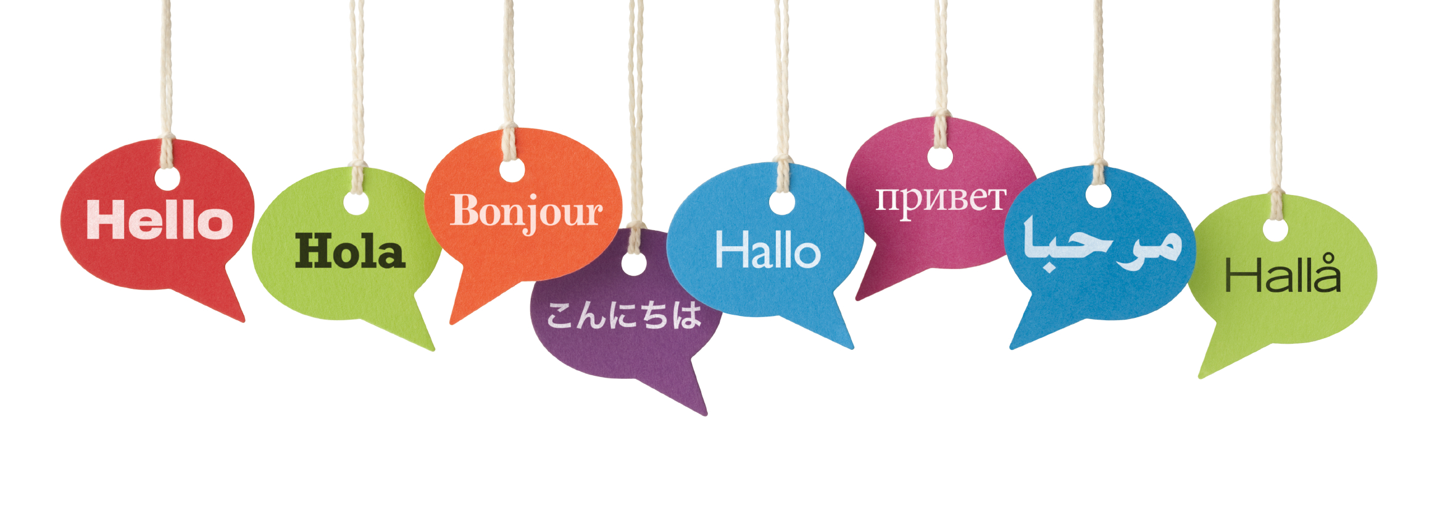
NLP
“Allows machines to process or understand natural language in order to perform useful tasks”
Notes:
Natural language processing or NLP is one of the hottest areas of AI today. NLP is a sub-field of artificial intelligence that is focused on enabling computers to understand and process human languages, to get computers closer to a human-level understanding of language.
Machines are great at working with standardized and structured data like database tables and financial records. They are able to process that data much faster than we humans can. But us humans don’t communicate in “structured data” nor do we speak binary! We communicate using words, a form of unstructured data.

Slide 10

Challenges
“I saw a man on a hill with a telescope”
There’s a man on a hill, and I’m watching him with my telescope.
There’s a man on a hill, who I’m seeing, and he has a telescope.
There’s a man, and he’s on a hill that also has a telescope on it.
I’m on a hill, and I saw a man using a telescope.
There’s a man on a hill, and I’m seeing him with a telescope
Notes:
Yet our Macs and PCs don’t yet have the same intuitive understanding of natural language that humans do. They can’t really understand what the language is really trying to say.
With NLP algorithms, we can get our machines closer to that deeper human level of understanding language. Today, NLP enables us to build things like chat bots, language translators, and automated systems to recommend you the best Netflix TV shows

Slide 11
Levels in NLP*
Pragmatic
Semantics
Syntactic
Morphological
Discourse
*Lexical − It involves identifying and analysing the structure of words. Lexical analysis is dividing the whole chunk of text into paragraphs, sentences, and words
Notes:
Syntactic curve - Keyword spotting, lexical affinity, statistical NLP
Semantic Curve - Endogenous NLP – latent semantic analysis, Latent Dirichlet Allocation (LDA), OWL/RDFS reasoning, Taxonomic NLP – WordNet, WikiTaxonomy, etc., Noetic NLP – connectionist systems such as neural nets
Pragmatics Curve - Computational models of narrative, Common sense reasoning
Microtext normalization – removing abbreviations etc. making it more formal.
Sentence boundary disambiguation – making sentence boundaries.
POS Tagging – whether different words are verb, noun etc.
Text chunking – grouping of words in syntactic structure like noun groups
Lemmatization – morphologically correct root form.
WSD – which sense is a word used? Fine as noun or fine as a verb?
Concept extraction – verb concepts such as slurp, eat, or munch grouped together as Ingest, while food concepts such as Pizzas, noodles etc. grouped together as Food.
Named Entity Recognition – persons, locations, organizations and miscellaneous.
Personality recognition – The Big Five (stream-of-consciousness).
Metaphor understanding – metaphors are used to substitute complex concepts with simpler ones.
Aspect extraction – product features
Polarity detection – positive or negative sentiment analysis

Slide 12
Levels in NLP
Pragmatic
Semantics
Syntactic
Morphological
Discourse
Deals with word structures and word formations
Focusing on the analysis of the individual components of words
“minimal unit of meaning”, is referred to as the morpheme
Example -“unhappiness”
prefix, stem, and suffix

Slide 13
Levels in NLP
Pragmatic
Semantics
Syntactic
Morphological
Discourse
“parsing”
extraction of phrases which convey more meaning than just the individual words
arranging words in a manner that shows the relationship among the words
Micro-text normalization, sentence boundary disambiguation, POS Tagging, Text chunking, lemmatization
Notes:
Microtext normalization – removing abbreviations etc. making it more formal.
Sentence boundary disambiguation – making sentence boundaries.
POS Tagging – whether different words are verb, noun etc.
Text chunking – grouping of words in syntactic structure like noun groups
Lemmatization – morphologically correct root form.

Slide 14
Levels in NLP
Pragmatic
Semantics
Syntactic
Morphological
Discourse
Semantics is what the well-formed symbols mean
Checked for its meaningfulness
Interpretation of the meaning of sentences, rather than the analysis at the level or individual words or phrases
Word sense disambiguation, concept extraction, subjectivity detection (sentiment analysis),NER
Notes:
It draws the exact meaning or the dictionary meaning from the text. The text is checked for meaningfulness. It is done by mapping syntactic structures and objects in the task domain. The semantic analyzer disregards sentence such as “hot ice-cream”.
In information retrieval, the query and document matching process can be performed on a conceptual level, as opposed to simple terms, thereby further increasing system precision
WSD – which sense is a word used? Fine as noun or fine as a verb?
Concept extraction – verb concepts such as slurp, eat, or munch grouped together as Ingest, while food concepts such as Pizzas, noodles etc. grouped together as Food.
Named Entity Recognition – persons, locations, organizations and miscellaneous.

Slide 15
Levels in NLP
Pragmatic
Semantics
Syntactic
Morphological
Discourse
Analysis of structure and meaning of text beyond a single sentence, making connections between words and sentences
Capability to recognize and resolve anaphora* relationships
Structured documents also benefit from the analysis at the discourse level since sections can be broken down into title, abstract, introduction, body, results, analysis, conclusion, and references
* most commonly in the form of, but not limited to, a pronoun
Notes:
The meaning of any sentence depends upon the meaning of the sentence just before it. In addition, it also brings about the meaning of immediately succeeding sentence.

Slide 16
Levels in NLP
Pragmatic
Semantics
Syntactic
Morphological
Discourse
Use of real-world knowledge and understanding how this impacts the meaning of what is being communicated
Analyse the contextual dimension of the documents and queries
Personality recognition, sarcasm detection, metaphor understanding, aspect extraction, polarity detection
Re-interpretation of what was said and what it actually meant
Example – “Fire”
* most commonly in the form of, but not limited to, a pronoun
Notes:
During this, what was said is re-interpreted on what it actually meant. It involves deriving those aspects of language which require real world knowledge.

Slide 17
Overlapping NLP Curves
Erik Cambria and Bebo White. 2014. Jumping NLP Curves: A Review of Natural Language Processing Research [Review Article]. Comp. Intell. Mag.9, 2 (May 2014), 48-57. DOI: https://doi.org/10.1109/MCI.2014.2307227
Notes:
Syntactic curve - Keyword spotting, lexical affinity, statistical NLP
Semantic Curve - Endogenous NLP – latent semantic analysis, Latent Dirichlet Allocation (LDA), OWL/RDFS reasoning, Taxonomic NLP – WordNet, WikiTaxonomy, etc., Noetic NLP – connectionist systems such as neural nets
Pragmatics Curve - Computational models of narrative, Common sense reasoning

Slide 18
NLP Use cases
Search Engines
Machine Translation
Sarcasm detection
Chatbots
Sentiment Analysis
Entity Recognition
Email classification
Text Summarization
Email next word suggestions
Autocorrect
Movie genre tagging
Topic Modeling
Fake news Detection

Slide 19
Techniques for NLP
Neural Networks
Avoid too much pre-processing
Assigning labels to words
Task dependent features
Extract rich set of hand-crafted features
Semantic role labeling task may require complex features
Avoid hand-crafted feature generation
Avoid task specific features
Better generalization
Features are learnt by the deep layers of the network taking as input only the sentences
Rule Based
Machine Learning
Define a set of rules which describe all the different aspects
Specify some sort of order or weight combination of those rules to make a final decision
Apply fixed set of rules to each and every input in the same way

Slide 20
NLP Pipeline
Text Collection
Structured
Text Processing
Cleaning
Feature Creation
Tokenization
Modelling
Unstructured
Imputing
Embeddings
Standard ML
Neural Network
Objective
Problem Definition
Data Sources

Slide 21
GCP SETUP

Slide 22
Google Cloud Platform
New User
a
Create new project
Enable Kubernetes API
Check the balance free credits
Estimated Cost (5 USD)
Sign up for a new GCP user account
Follow the next steps in Tutorial
Enable free credits to user GCP
Existing User

Slide 23
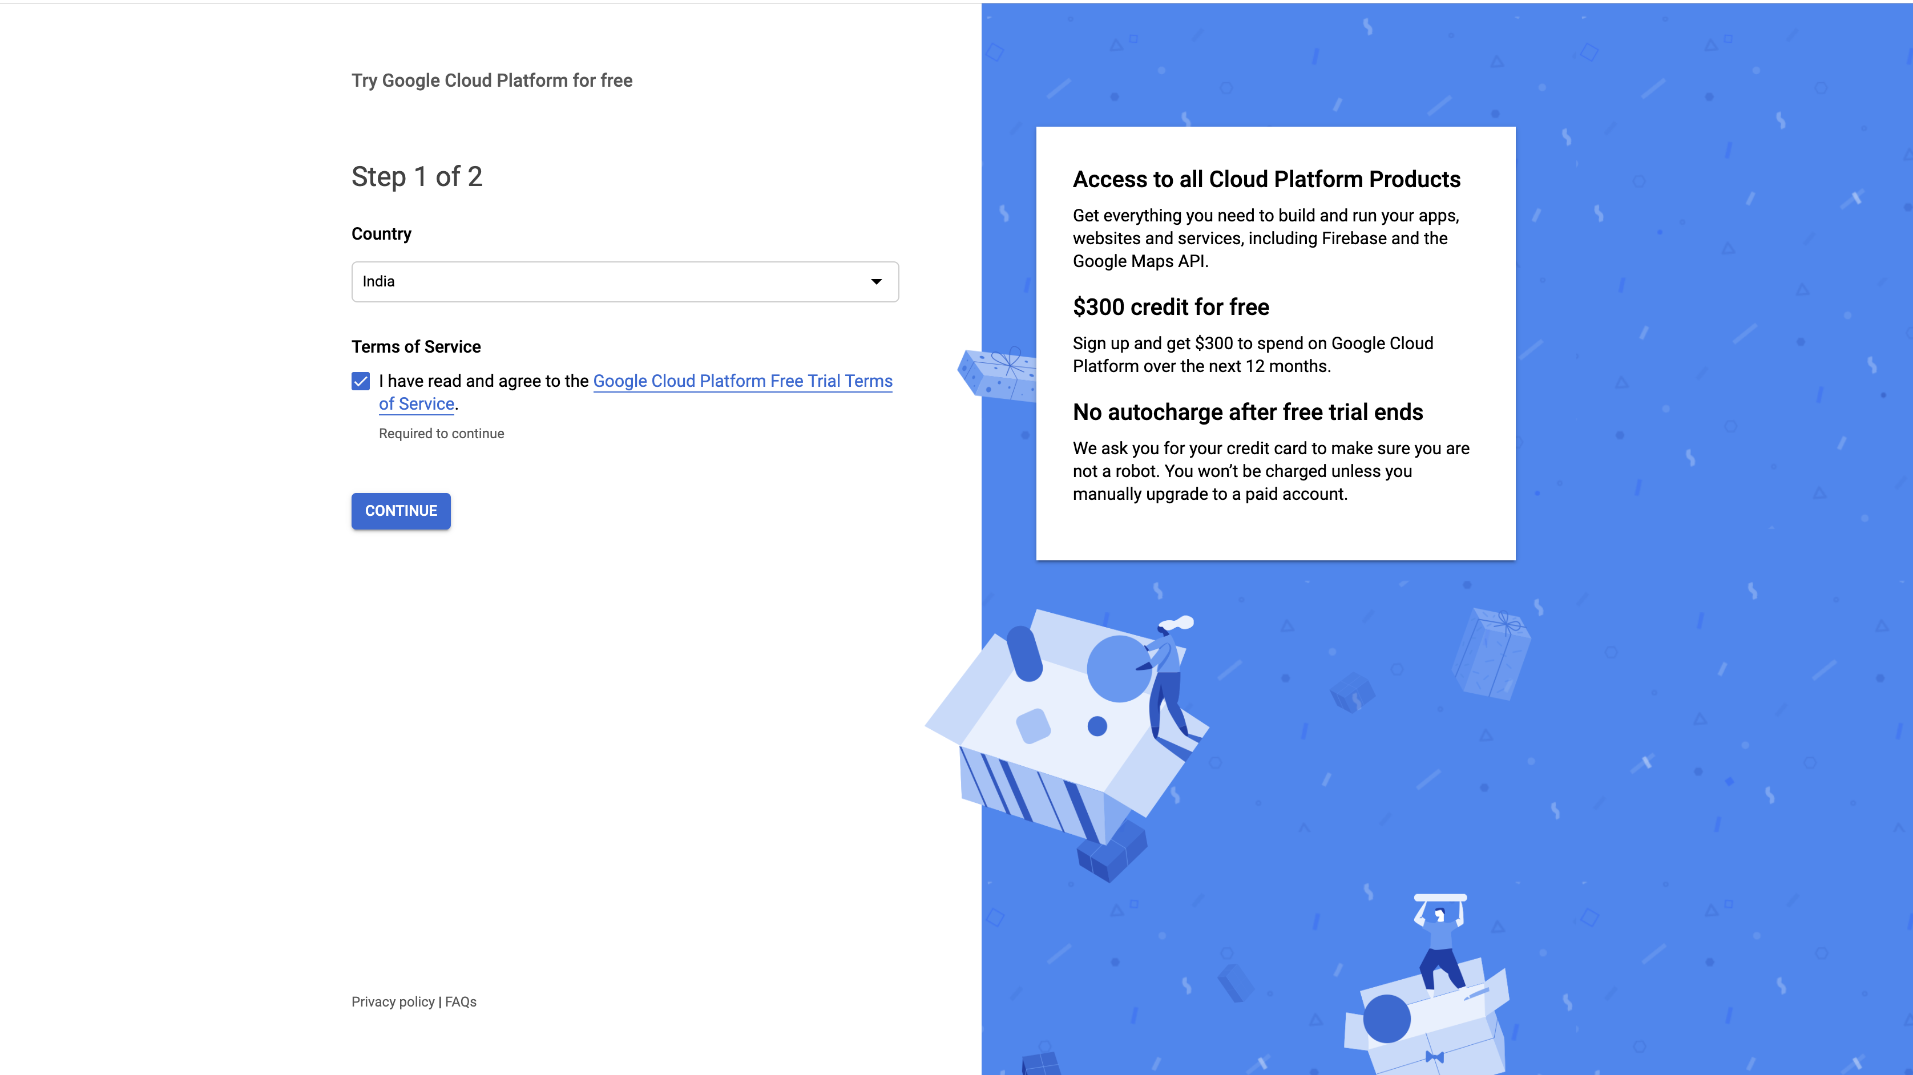
Step : 1

Slide 24
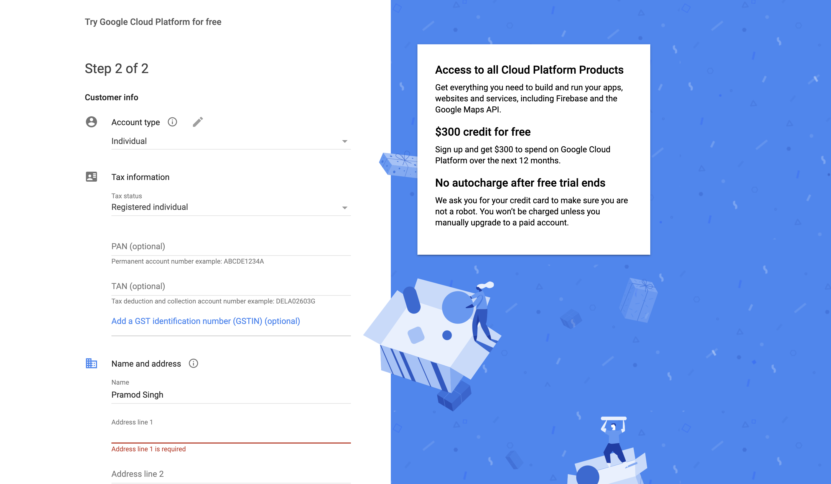
Step : 2

Slide 25
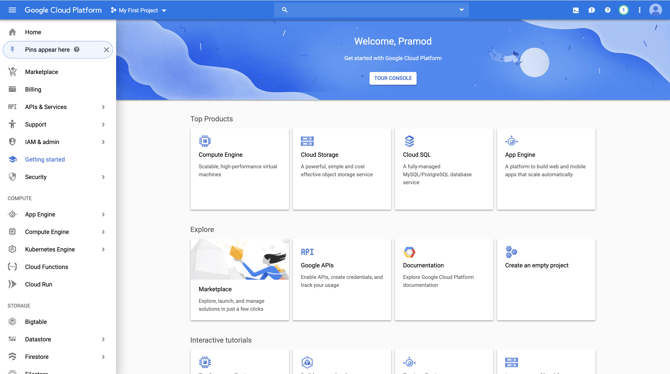
Step : 3

Slide 26
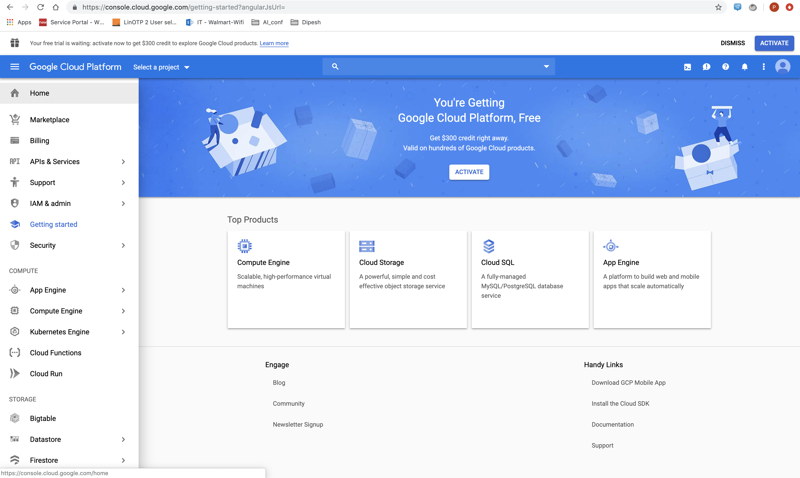
Step : 4

Slide 27
Step : 5
Step : 6

Slide 28
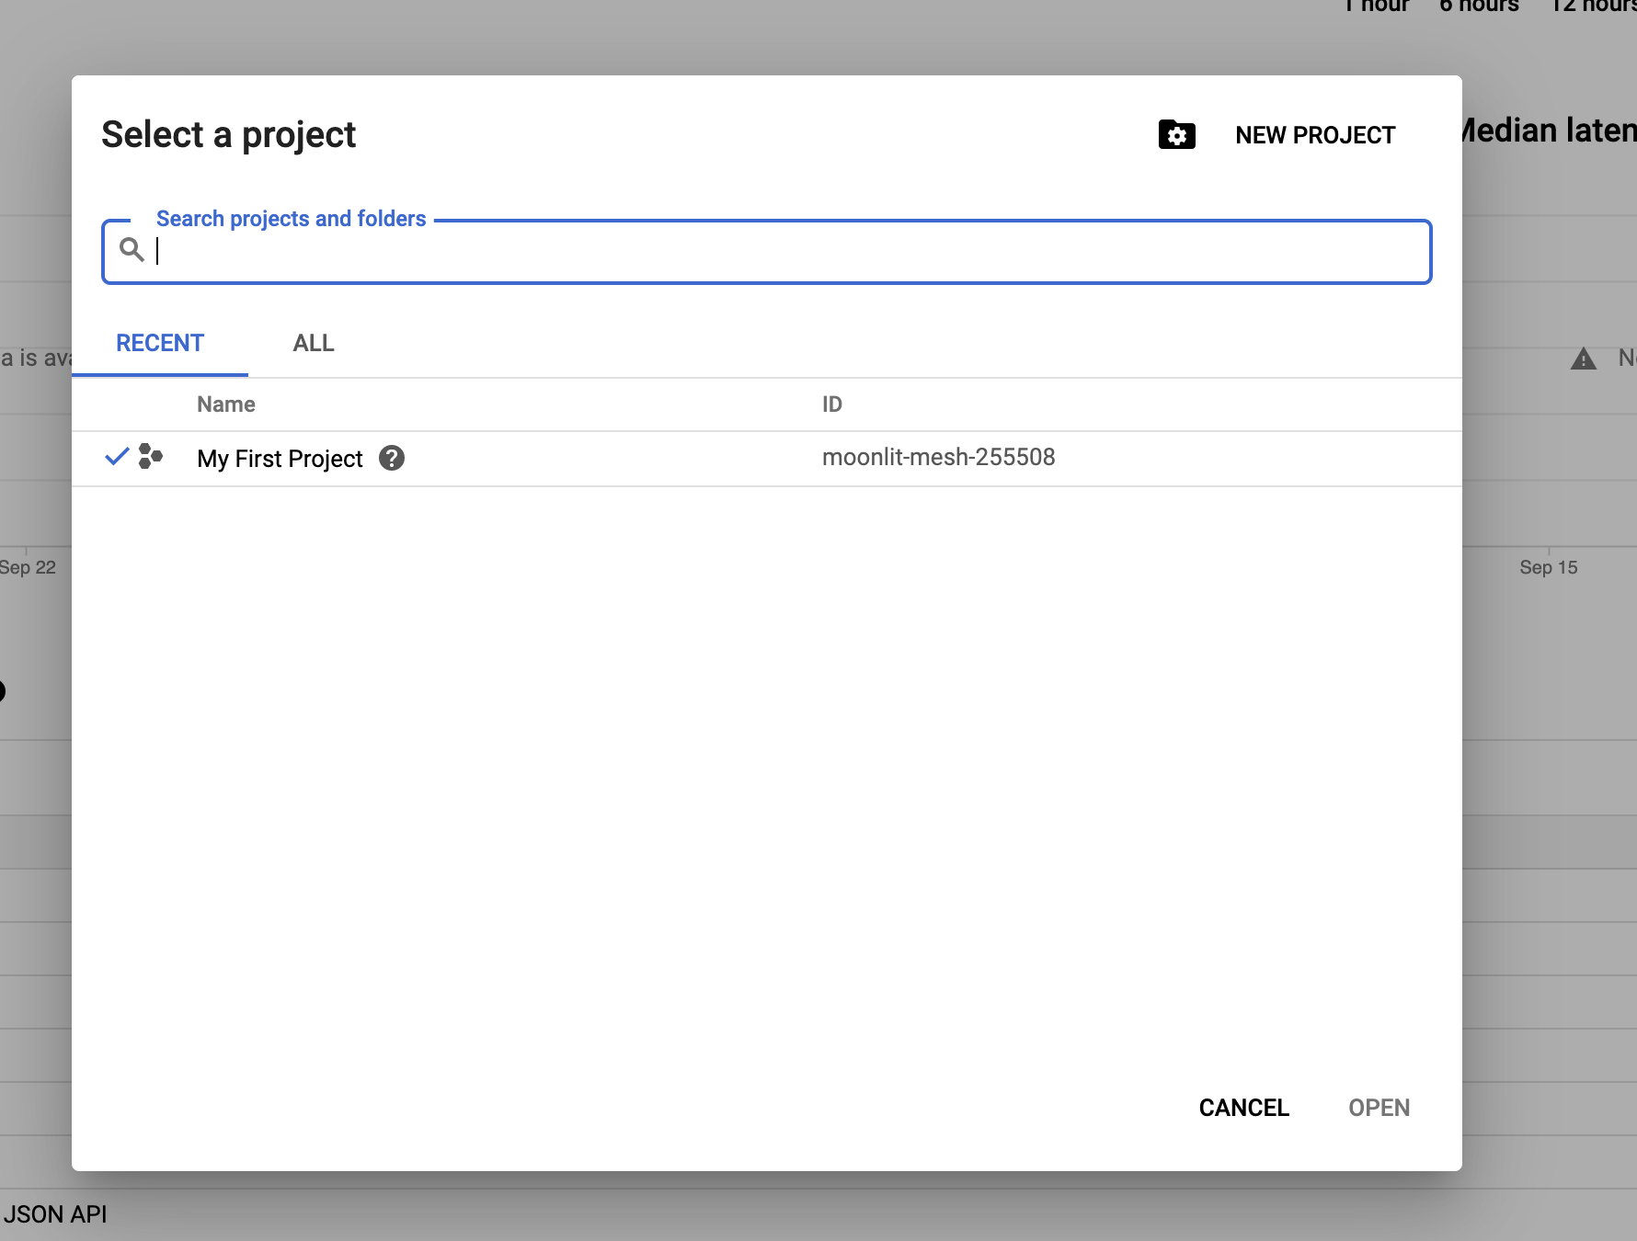
Step : 7

Slide 29
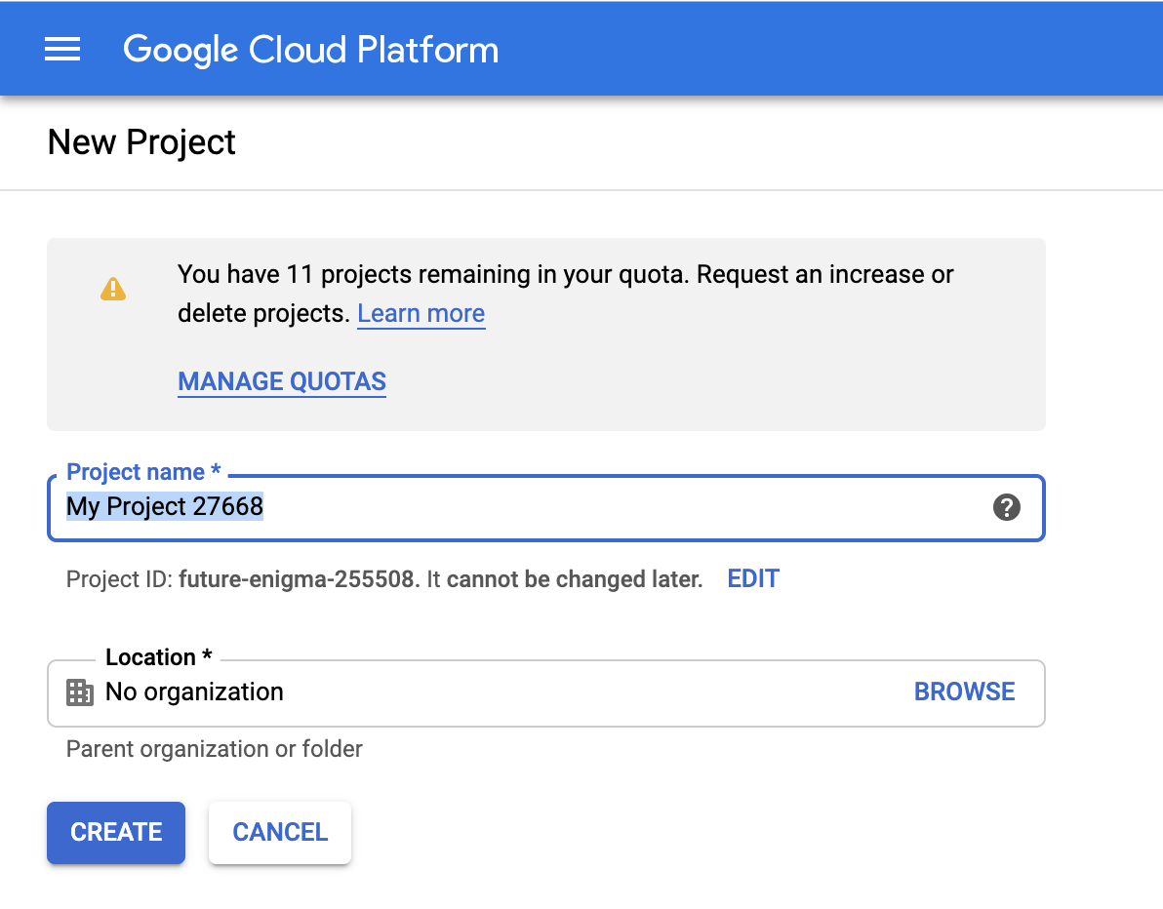
Step : 8

Slide 30
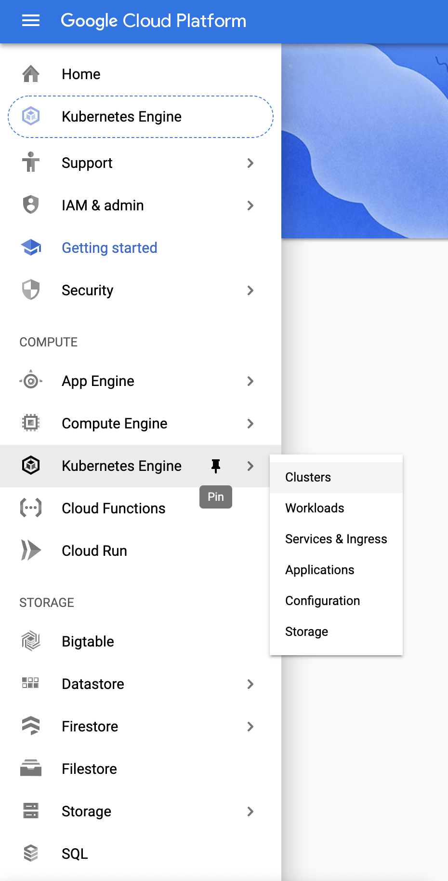
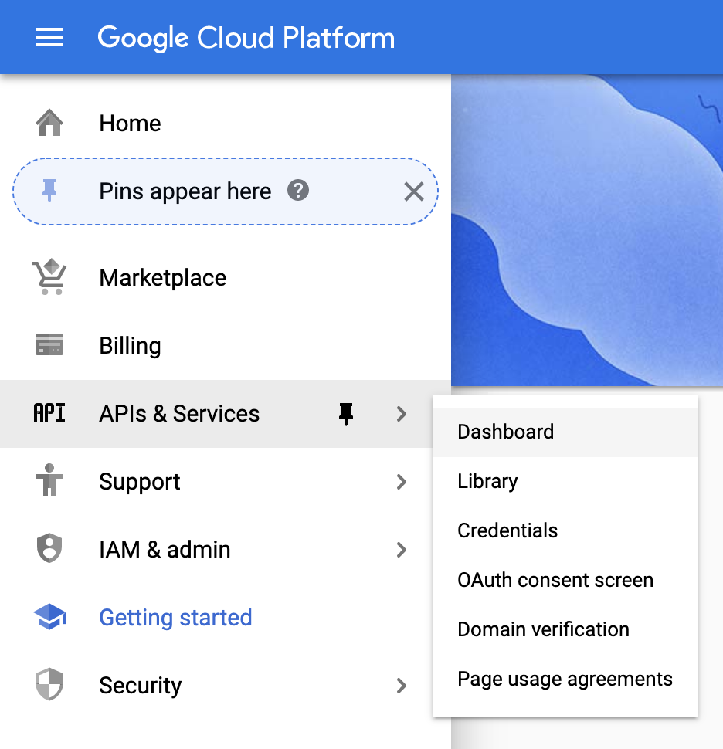
Step : 9

Slide 31
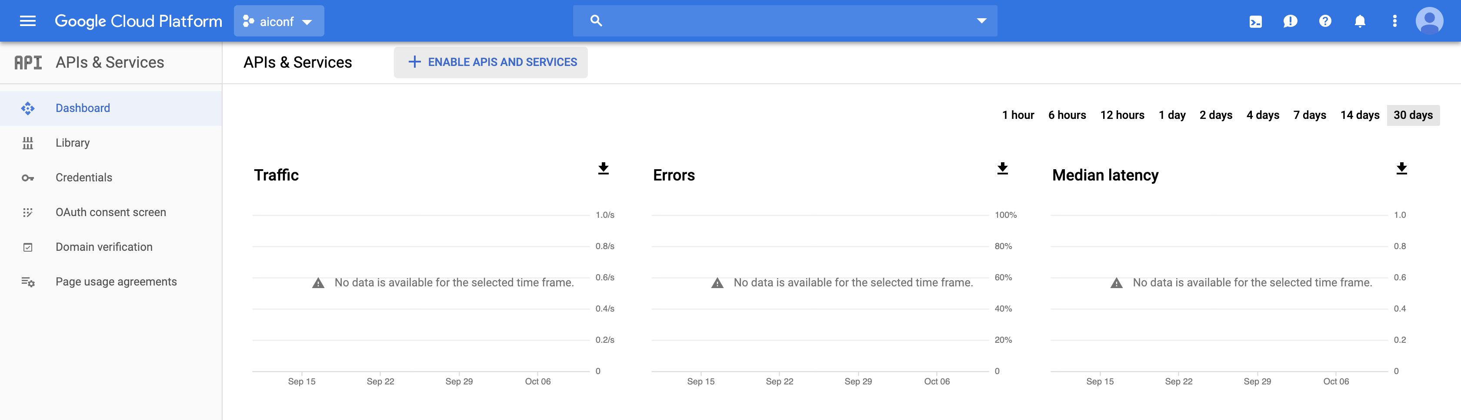
Step : 10

Slide 32
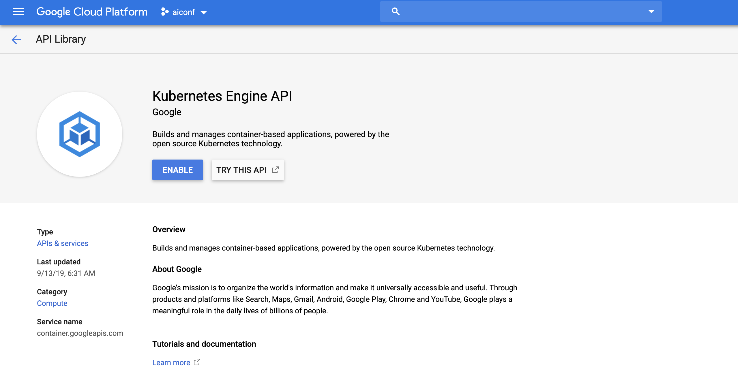
Step : 11

Slide 33

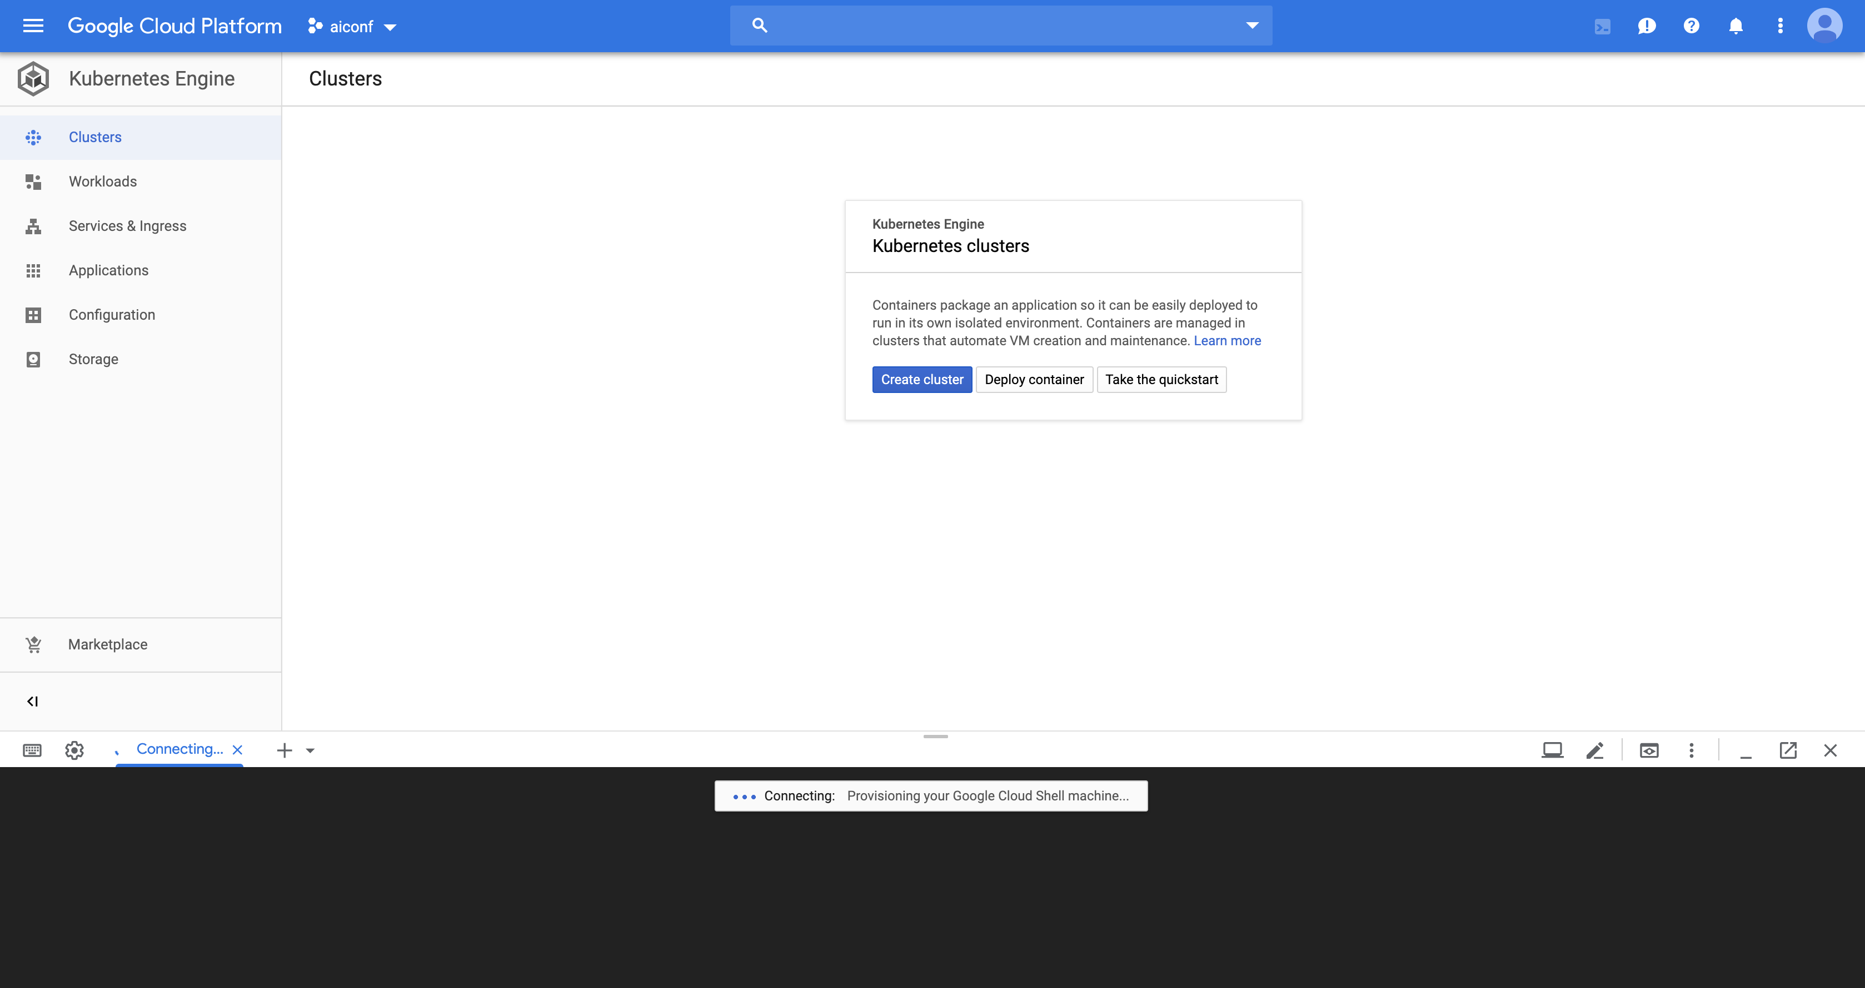
Step : 12

Slide 34
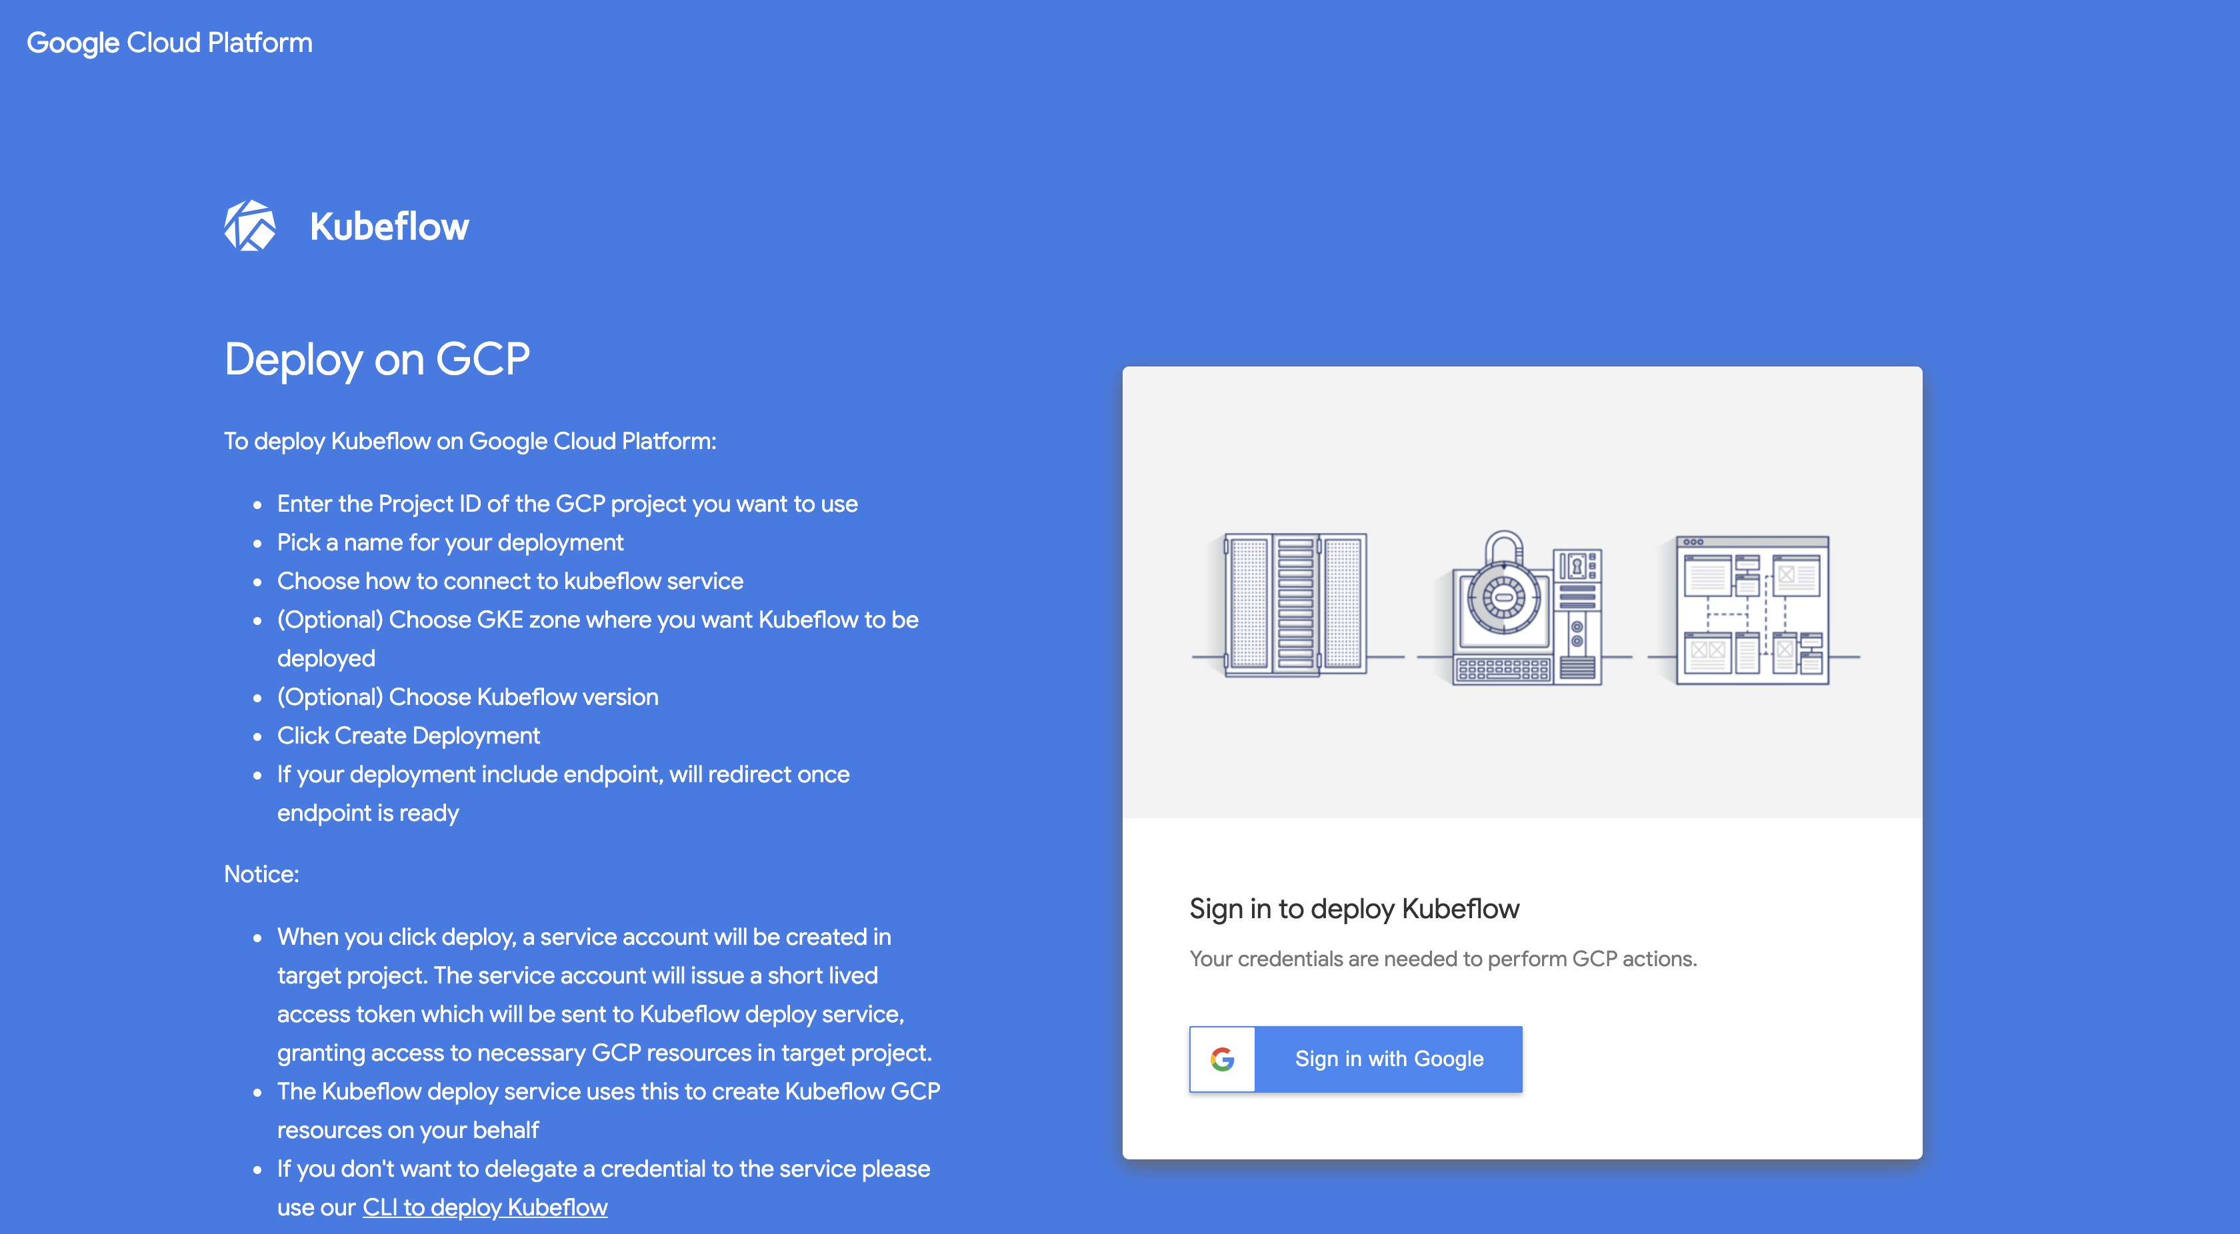
Step : 13

Slide 35
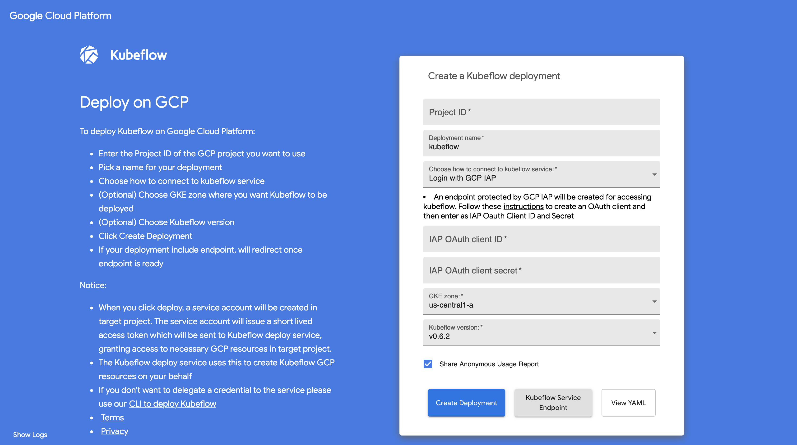
Step : 14

Slide 36
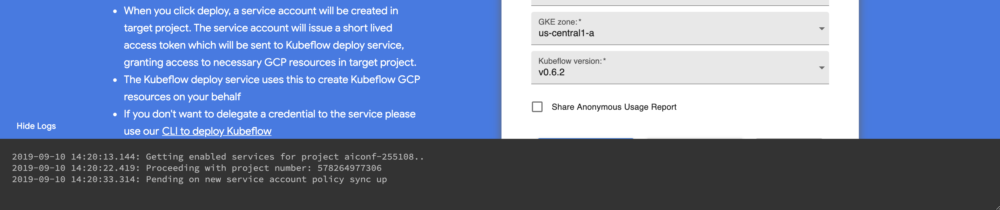
Step : 15

Slide 37
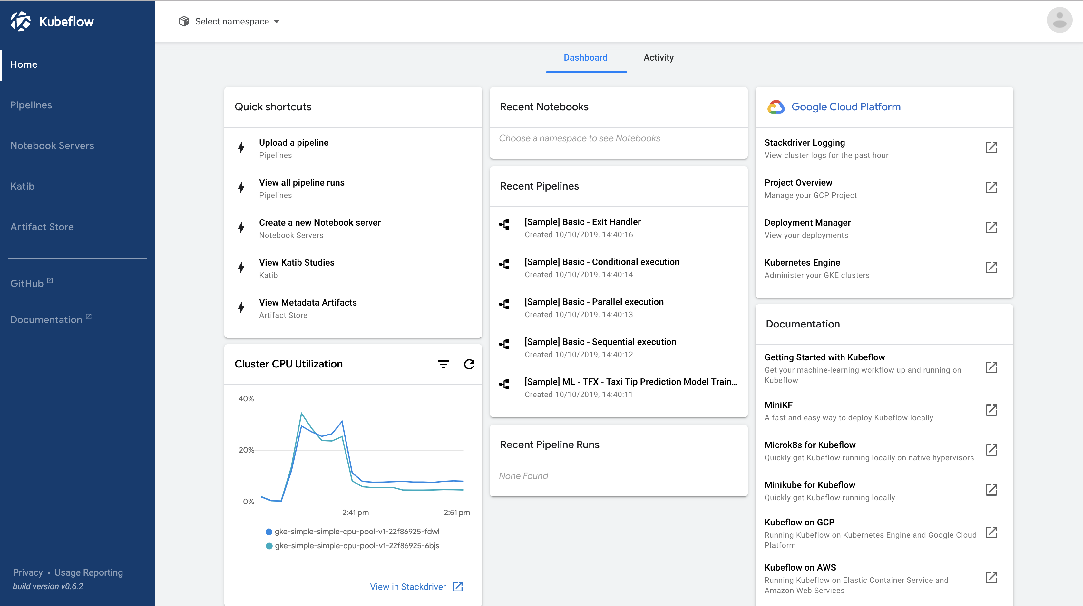
Step : 16

Slide 38
TEXT summarization

Slide 40
What
“Text summarization is the technique for generating a concise and precise summary of voluminous texts while focusing on the sections that convey useful information, and without losing the overall meaning”

Slide 41
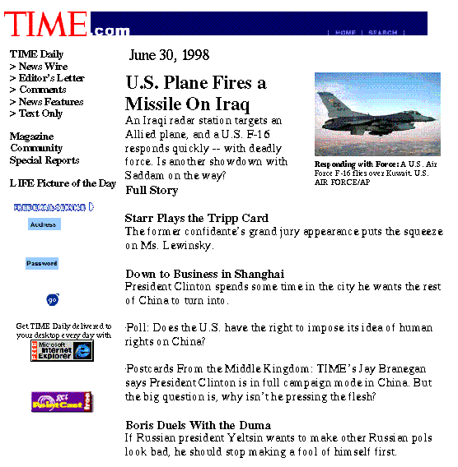
Headline news — informing

Slide 42
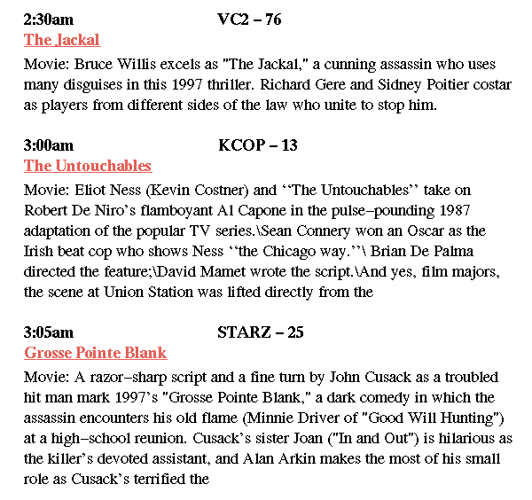
TV-GUIDES — decision making

Slide 43
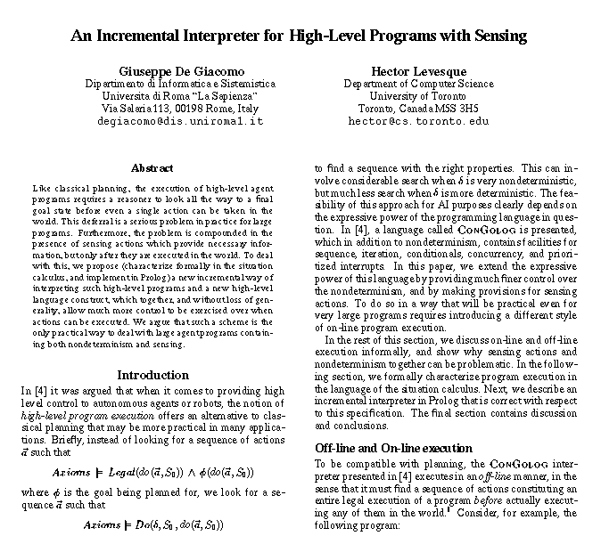
Abstracts of papers — time saving

Slide 44
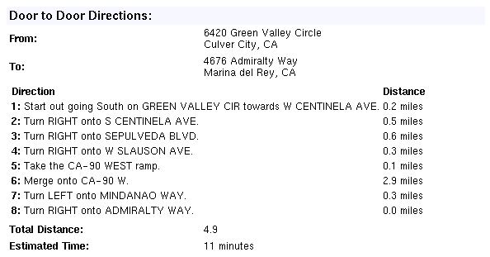
Textual Directions — planning

Slide 45
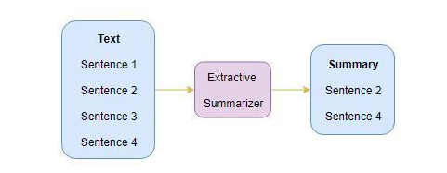
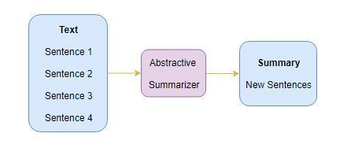
Types
Extraction-based summarization
The extracted summary can contain new phrases and sentences that represent the most important information from the source text
Better at overcoming the grammatical inaccuracies of the extraction techniques
Requires more sophisticated and complicated techniques
A subset of words that represent the most important points is pulled from a piece of text and combined to make a summary
Think of it as a highlighter—which selects the main information from a source text
Involves weighing the essential sections of sentences and using the results to generate summaries
Abstraction-based summarization

Slide 46
Approaches

Slide 47
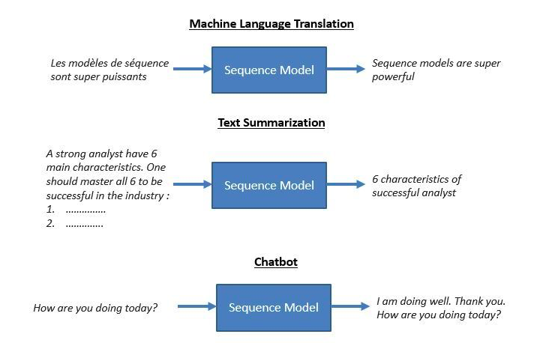
Seq2Seq

Slide 48
Applications

Slide 49
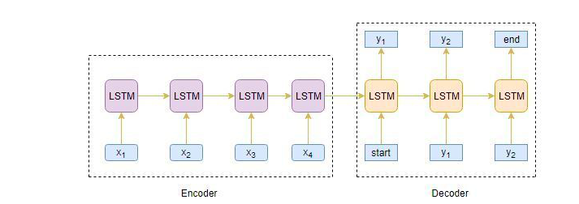
Encoder and Decoder Model
Notes:
A typical sequence to sequence model has two parts – an encoder and a decoder. Both the parts are practically two different neural network models combined into one giant network.
Broadly, the task of an encoder network is to understand the input sequence, and create a smaller dimensional representation of it. This representation is then forwarded to a decoder network which generates a sequence of its own that represents the output.
Encoder: An RNN model that reads the entire source sequence to a fixed-length encoding.
An Encoder Long Short Term Memory model (LSTM) reads the entire input sequence wherein, at each timestep, one word is fed into the encoder. It then processes the information at every timestep and captures the contextual information present in the input sequence.
The decoder is also an LSTM network which reads the entire target sequence word-by-word and predicts the same sequence offset by one timestep. The decoder is trained to predict the next word in the sequence given the previous word.
Decoder: An RNN model that uses the encoded input sequence and decodes it to output the target sequence.

Slide 50
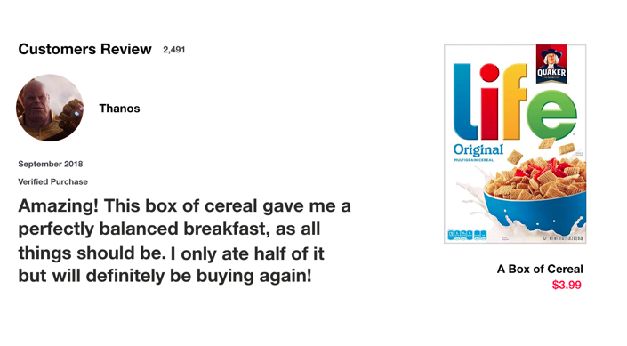
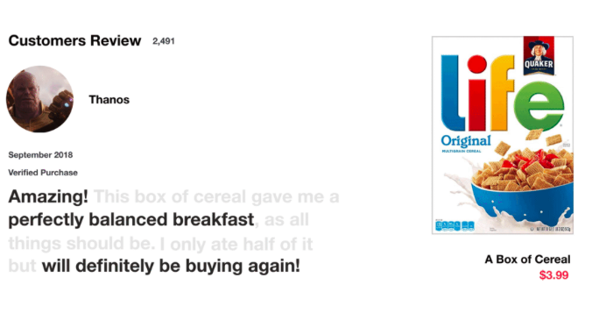
Intuition behind LSTM & GRU
Notes:
Ok, Let’s start with a thought experiment. Let’s say you’re looking at reviews online to determine if you want to buy Life cereal (don’t ask me why). You’ll first read the review then determine if someone thought it was good or if it was bad.
When you read the review, your brain subconsciously only remembers important keywords. You pick up words like “amazing” and “perfectly balanced breakfast”. You don’t care much for words like “this”, “gave“, “all”, “should”, etc. If a friend asks you the next day what the review said, you probably wouldn’t remember it word for word. You might remember the main points though like “will definitely be buying again”. If you’re a lot like me, the other words will fade away from memory.
And that is essentially what an LSTM or GRU does. It can learn to keep only relevant information to make predictions, and forget non relevant data. In this case, the words you remembered made you judge that it was good.

Slide 51
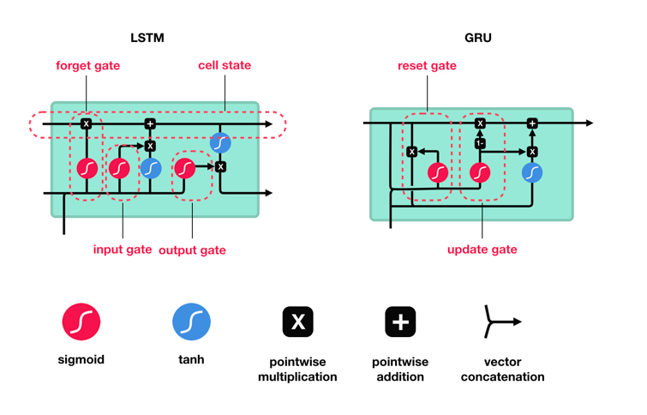
RNN variants in Encoder and Decoder Model
LSTM
GRU
Bi-directional
Notes:
LSTM ’s and GRU’s were created as the solution to short-term memory and vanishing gradient problem
LSTM (Long Short Term Memory): LSTM has three gates (input, output and forget gate)
GRU (Gated Recurring Units): GRU has two gates (reset and update gate).
Update Gate
The update gate acts similar to the forget and input gate of an LSTM. It decides what information to throw away and what new information to add.
Reset Gate
The reset gate is another gate is used to decide how much past information to forget.
THey are not as such very different, but gru have lesser parameters so they take lesser time to train and generalize.
Great Men never dies. They live in our hearts
Great wall of china is amazing to watch
In both these sentences, word Great means different and its meaning cannot be understood exactly using LSTM/GRU because this is the first word of the sentence and there is no other words with which LSTM/GRU can relate to understand the context. Here comes the use case of bidirectional RNN where learning is done from both the end and hence the meaning of the word is understood using the context both forward and reverse.

Slide 52
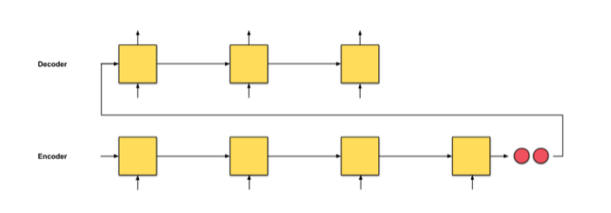
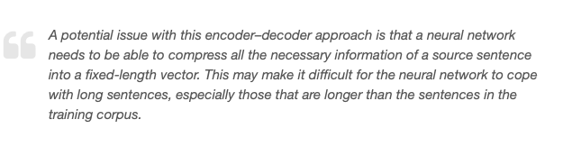
Limitations of the Encoder – Decoder Architecture
As useful as this encoder-decoder architecture is, there are certain limitations that come with it.
The encoder converts the entire input sequence into a fixed length vector and then the decoder predicts the output sequence. This works only for short sequences since the decoder is looking at the entire input sequence for the prediction
Here comes the problem with long sequences. It is difficult for the encoder to memorize long sequences into a fixed length vector
Notes:
The trouble with seq2seq is that the only information that the decoder receives from the encoder is the last encoder hidden state (the 2 tiny red nodes in Fig. 0.1), a vector representation which is like a numerical summary of an input sequence. So, for a long input text (Fig. 0.2), we unreasonably expect the decoder to use just this one vector representation (hoping that it ‘sufficiently summarises the input sequence’) to output a translation. This might lead to catastrophic forgetting. This paragraph has 100 words. Can you translate this paragraph to another language you know, right after this question mark?
If we can’t, then we shouldn’t be so cruel to the decoder. How about instead of just one vector representation, let’s give the decoder a vector representation from every encoder time step so that it can make well-informed translations? Enter attention.
So how do we overcome this problem of long sequences? This is where the concept of attention mechanism comes into the picture. It aims to predict a word by looking at a few specific parts of the sequence only, rather than the entire sequence. It really is as awesome as it sounds!

Slide 53
Attention mechanism

Slide 54
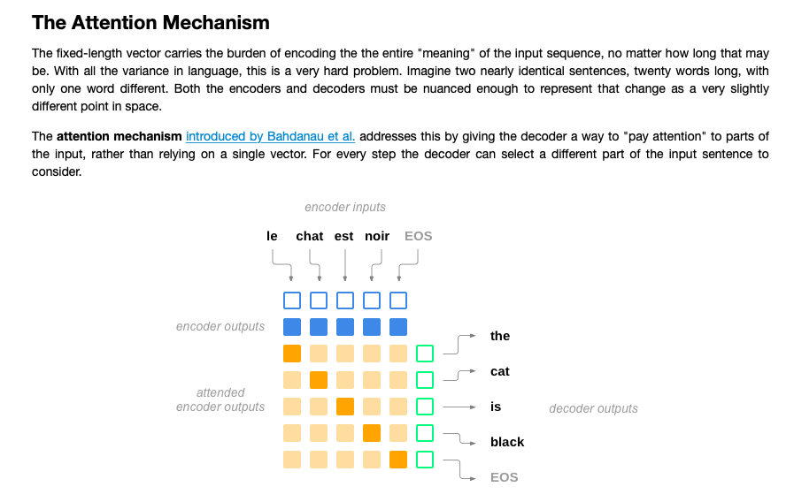
Attention Mechanism
The attention mechanism addresses the previous discussed issue by giving the decoder to “pay attention” to the parts of the input rather than relying on a single vector. For every step, the decoder can select a different part of the input sentence to consider.
Notes:
Attention is calculated with another feedforward layer in the decoder. This layer will use the current input and hidden state to create a new vector, which is the same size as the input sequence (in practice, a fixed maximum length). This vector is processed through softmax to create attention weights, which are multiplied by the encoders' outputs to create a new context vector, which is then used to predict the next output.

Slide 55
Intuition behind the Attention Mechanism
How much attention do we need to pay to every word in the input sequence for generating a word at timestep t? That’s the key intuition behind this attention mechanism concept.
Let’s consider a simple example to understand how Attention Mechanism works:
Source sequence: “Which sport do you like the most?
Target sequence: “I love football”
There are 2 different classes of attention mechanism depending on the way the attended context vector is derived:
Global Attention
Local Attention
Notes:
The first word ‘I’ in the target sequence is connected to the fourth word ‘you’ in the source sequence, right? Similarly, the second-word ‘love’ in the target sequence is associated with the fifth word ‘like’ in the source sequence.
So, instead of looking at all the words in the source sequence, we can increase the importance of specific parts of the source sequence that result in the target sequence. This is the basic idea behind the attention mechanism.
Global Attention:
Here, the attention is placed on all the source positions. In other words, all the hidden states of the encoder are considered for deriving the attended context vector:
Local Attention:
Here, the attention is placed on only a few source positions. Only a few hidden states of the encoder are considered for deriving the attended context vector:

Slide 56
Attention Mechanism
Removes the information bottleneck
Gives access to the whole input, not just current step
Provides a query mechanism to decide what data is important at this point in time.
Provides us with attention weights
Interpretation of what is going on.
Notes:
Attention places different focus on different words by assigning each word with a score. Then, using the softmaxed scores, we aggregate the encoder hidden states using a weighted sum of the encoder hidden states, to get the context vector. The implementations of an attention layer can be broken down into 4 steps

Slide 57
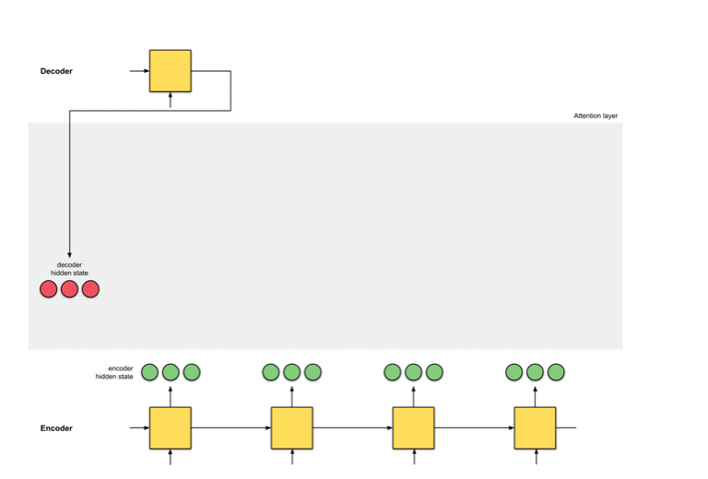
Step 0: Prepare hidden states.
Notes:
Let’s first prepare all the available encoder hidden states (green) and the first decoder hidden state (red). In our example, we have 4 encoder hidden states and the current decoder hidden state. (Note: the last consolidated encoder hidden state is fed as input to the first time step of the decoder. The output of this first time step of the decoder is called the first decoder hidden state, as seen below.)

Slide 58
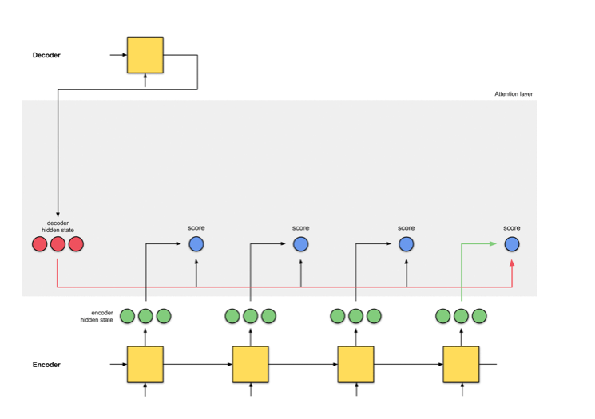
Step 1: Obtain a score for every encoder hidden state
Notes:
A score (scalar) is obtained by a score function (also known as alignment score function [2] or alignment model [1]). In this example, the score function is a dot product between the decoder and encoder hidden states.

Slide 59
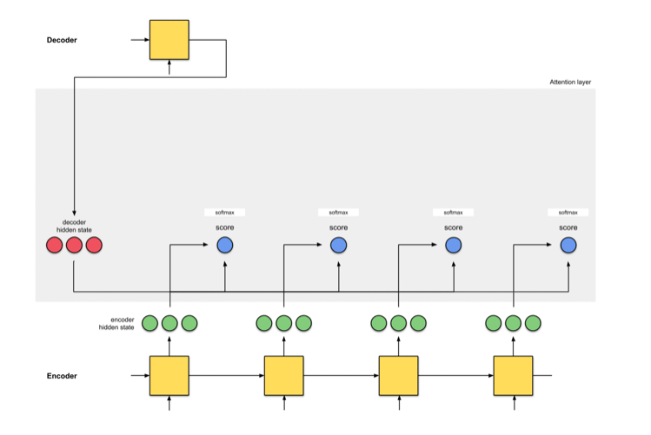
Step 2: Run all the scores through a softmax layer.
Notes:
We put the scores to a softmax layer so that the softmaxed scores (scalar) add up to 1. These softmaxed scores represent the attention distribution

Slide 60
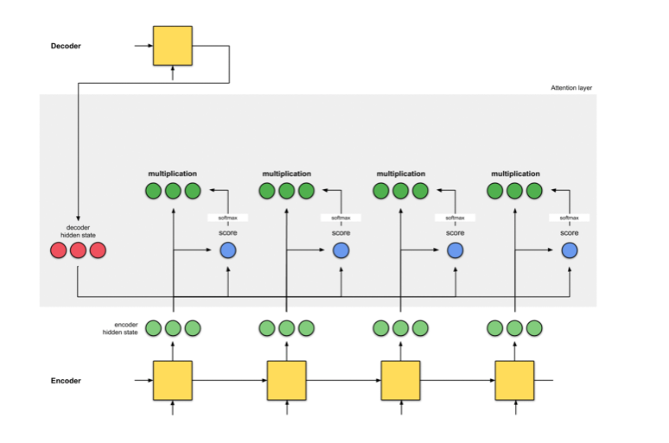
Step 3: Multiply each encoder hidden state by its softmaxed score.
Notes:
By multiplying each encoder hidden state with its softmaxed score (scalar), we obtain the alignment vector [2] or the annotation vector [1]. This is exactly the mechanism where alignment takes place.

Slide 61
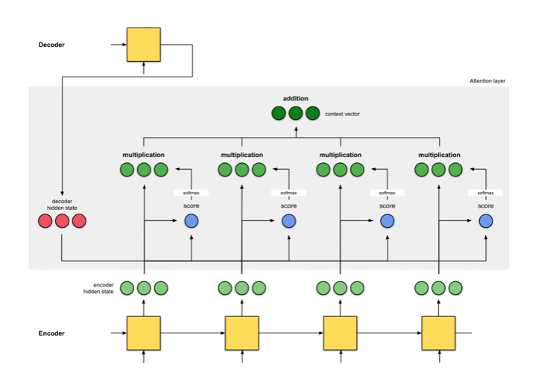
Step 4: Sum up the alignment vectors.
Notes:
The alignment vectors are summed up to produce the context vector [1, 2]. A context vector is an aggregated information of the alignment vectors from the previous step.

Slide 62
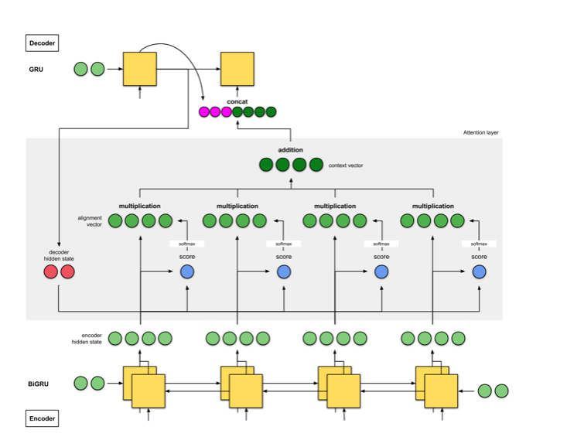
Step 5: Feed the context vector into the decoder.
Notes:
The encoder is a bidirectional (forward+backward) gated recurrent unit (BiGRU). The decoder is a GRU whose initial hidden state is a vector modified from the last hidden state from the backward encoder GRU (not shown in the diagram below).
The score function in the attention layer is the additive/concat.
The input to the next decoder step is the concatenation between the generated word from the previous decoder time step (pink) and context vector from the current time step (dark green).

Slide 63
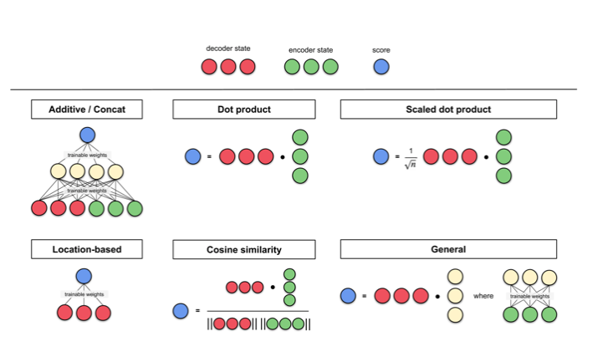
Score Functions
Notes:
Here are some of the score functions as compiled by Lilian Weng. Additive/concat and dot product have been mentioned in this article. The idea behind score functions involving the dot product operation (dot product, cosine similarity etc.), is to measure the similarity between two vectors. For feed-forward neural network score functions, the idea is to let the model learn the alignment weights together with the translation.

Slide 64
Sequence-to-Sequence Models
Attention in Sequence-to-Sequence Models
https://blog.floydhub.com/attention-mechanism/
https://blog.floydhub.com/attention-mechanism/

Slide 65
How can we Improve the Model’s Performance Even Further?
Your learning doesn’t stop here! There’s a lot more you can do to play around and experiment with the model:
Recommend you to increase the training dataset size and build the model. The generalization capability of a deep learning model enhances with an increase in the training dataset size
Try implementing Bi-Directional LSTM which is capable of capturing the context from both the directions and results in a better context vector
Use the beam search strategy for decoding the test sequence instead of using the greedy approach (argmax)

Slide 66
DEMO I –Jupyter Notebook

Slide 67

Login into Kubeflow Server
Step : 1

Slide 68
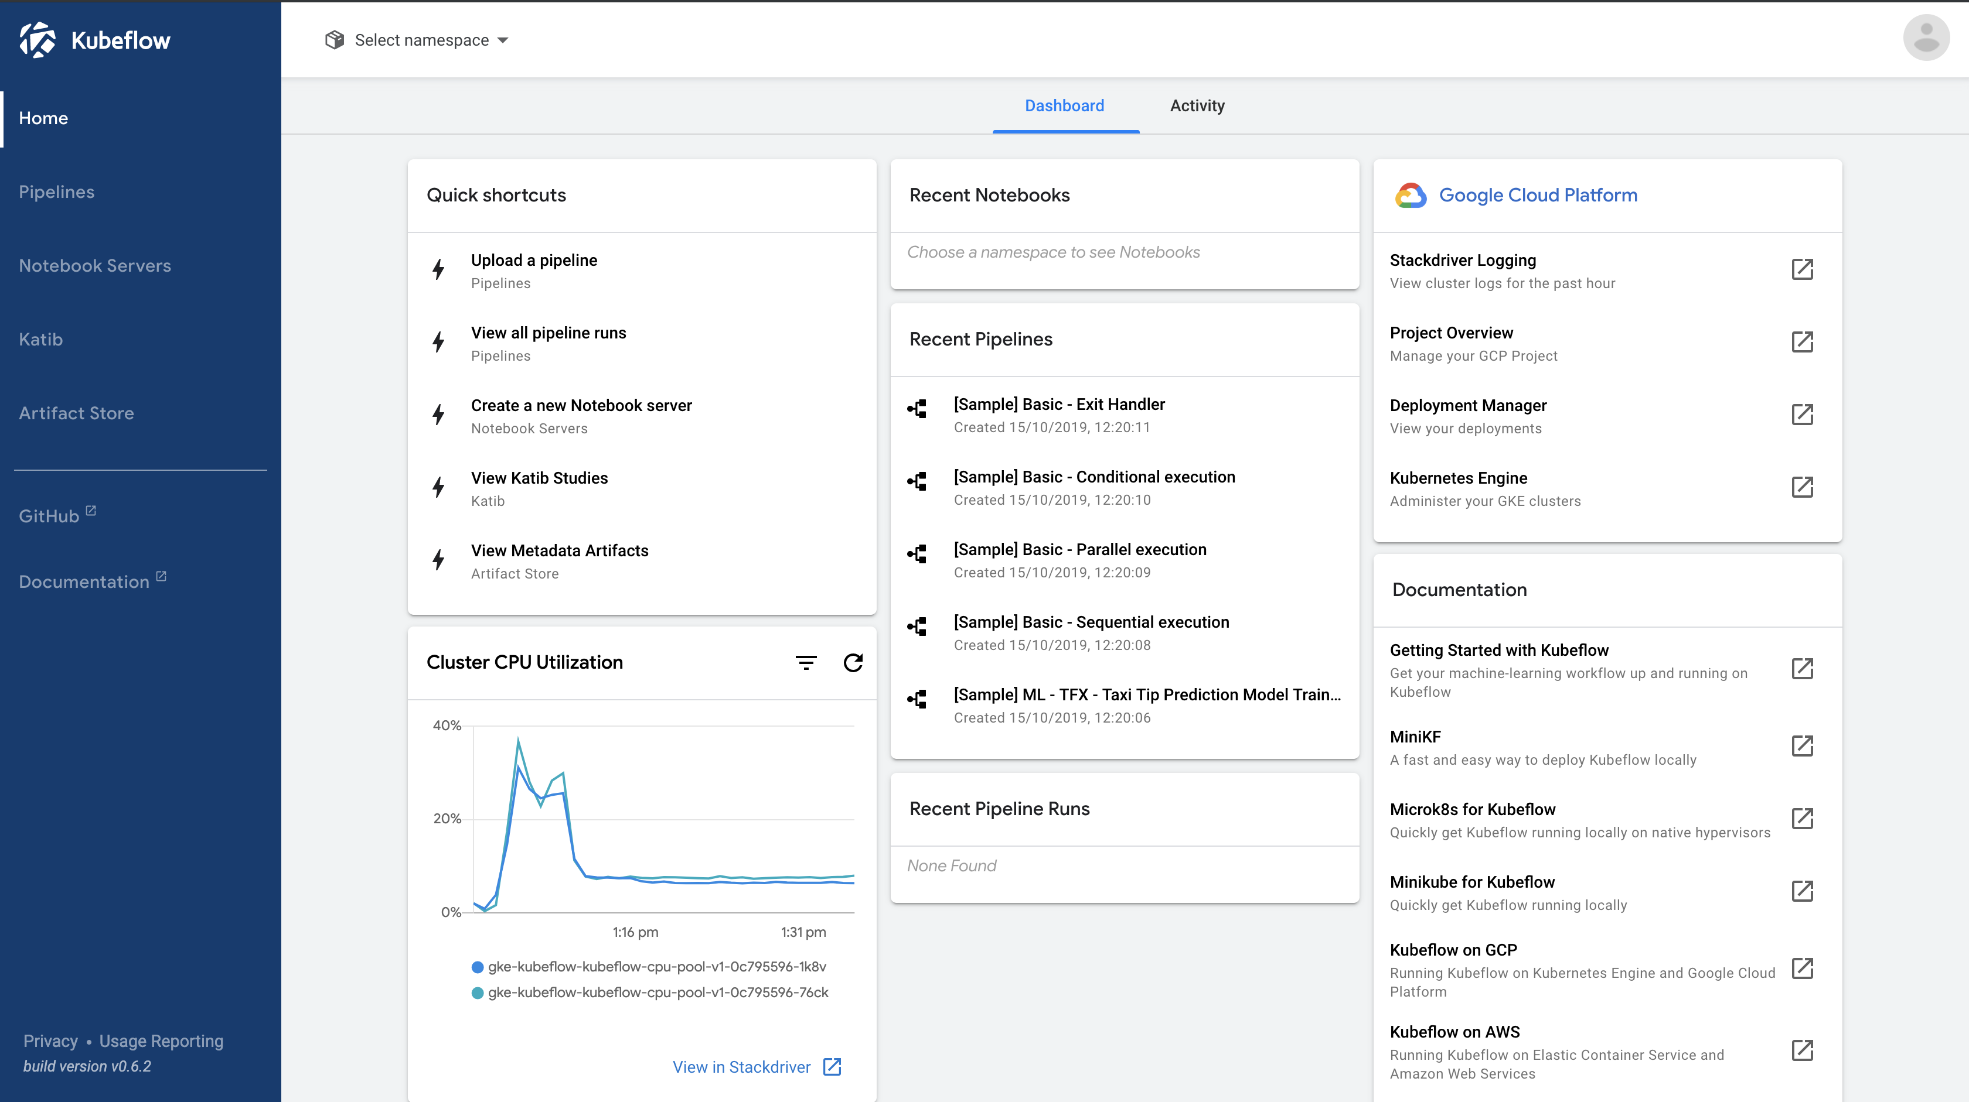
Kubeflow UI
Step : 2

Slide 69
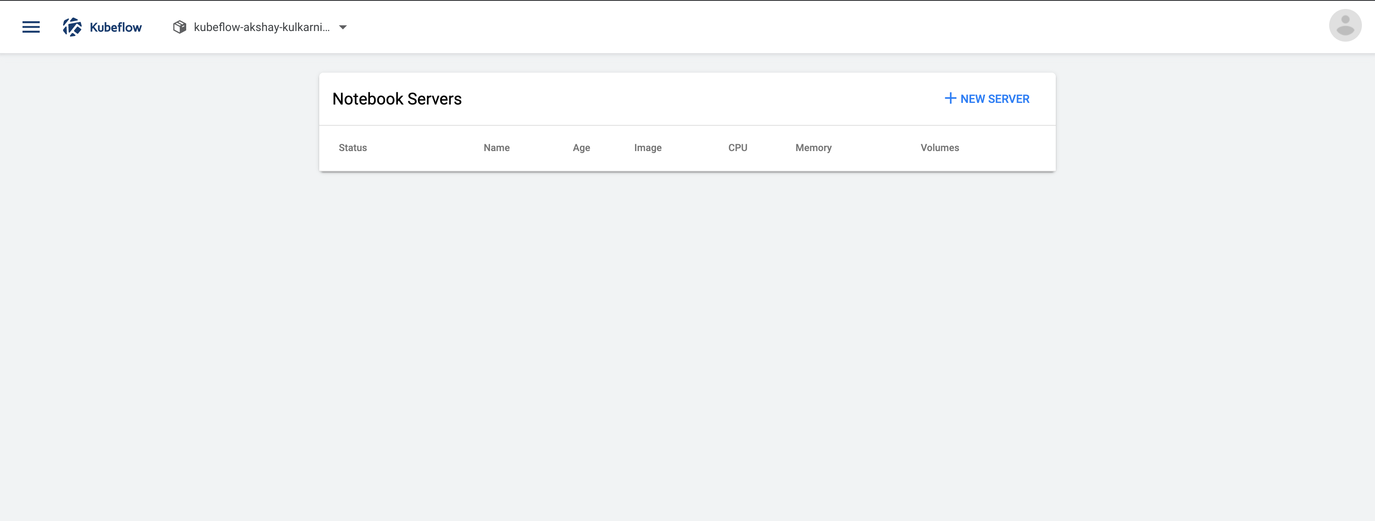
Start a new Notebook Server
Step : 3

Slide 70
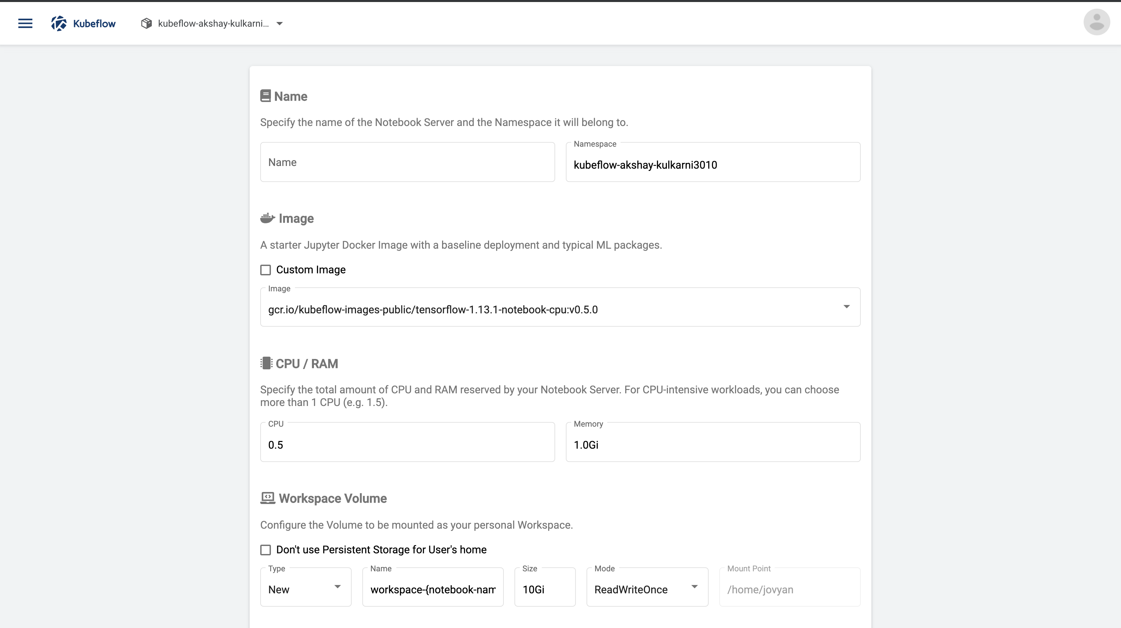
Assign a name to Notebook Server
Step : 4

Slide 71
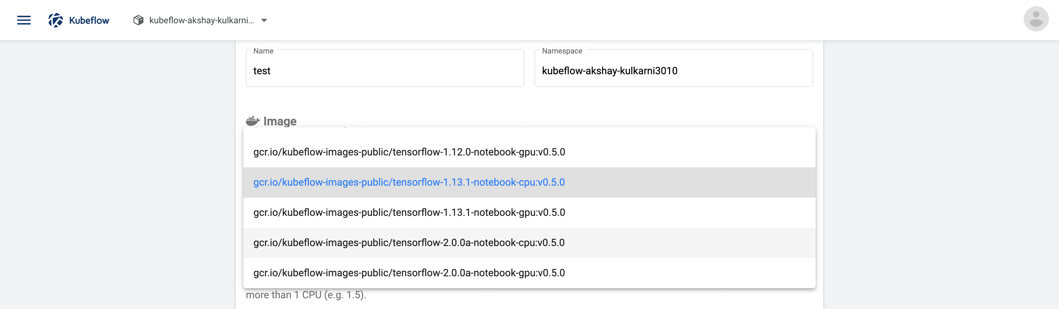
Select the Base Image
Step : 5

Slide 72

Select the CPU/RAM
Step : 6

Slide 73

Add GCP credentials (optional)
Step : 6

Slide 74
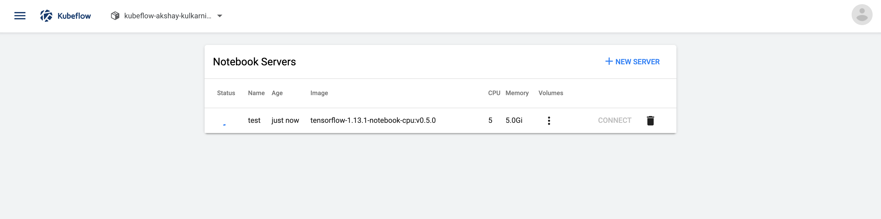
Kubeflow Server Start
Step : 7

Slide 75
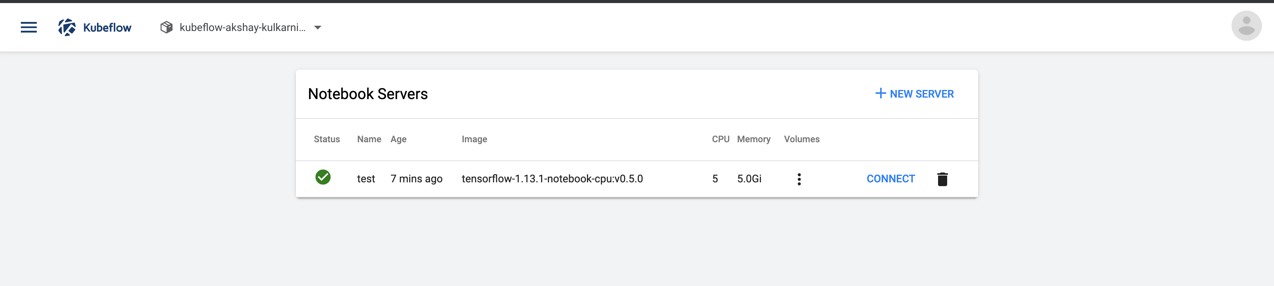
Connect to Kubeflow Server
Step : 8

Slide 76
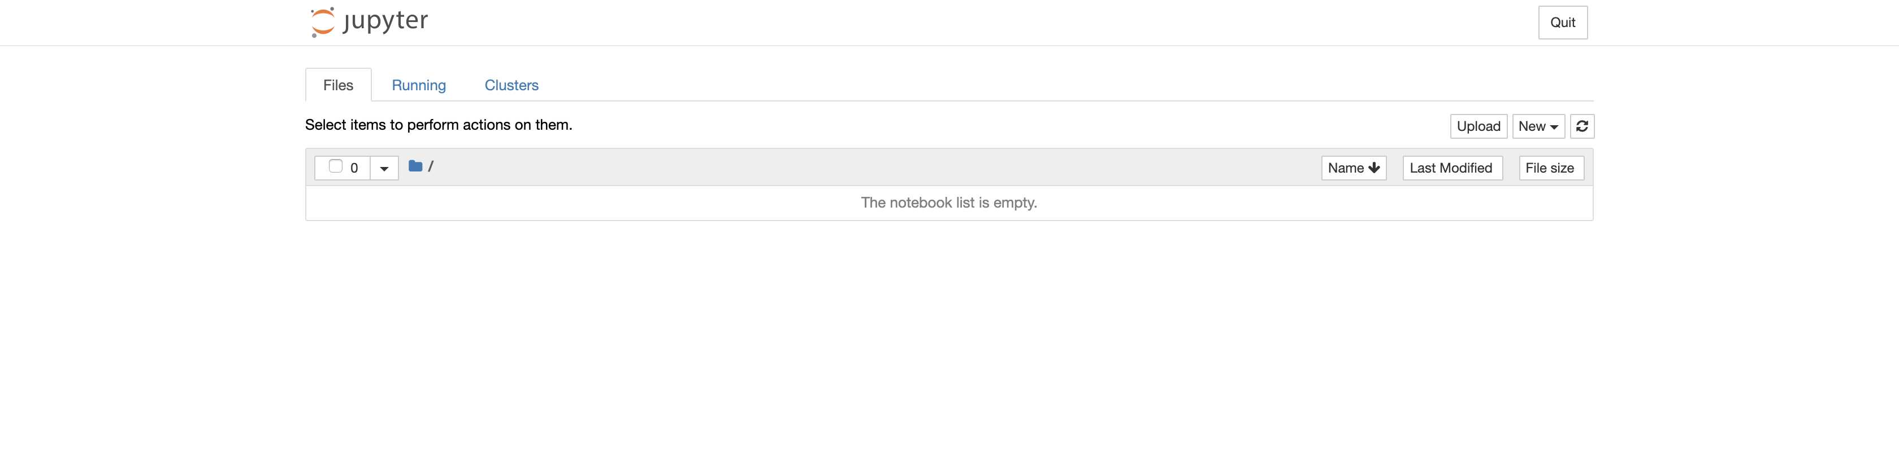
Jupyter Notebook
Step : 9

Slide 77
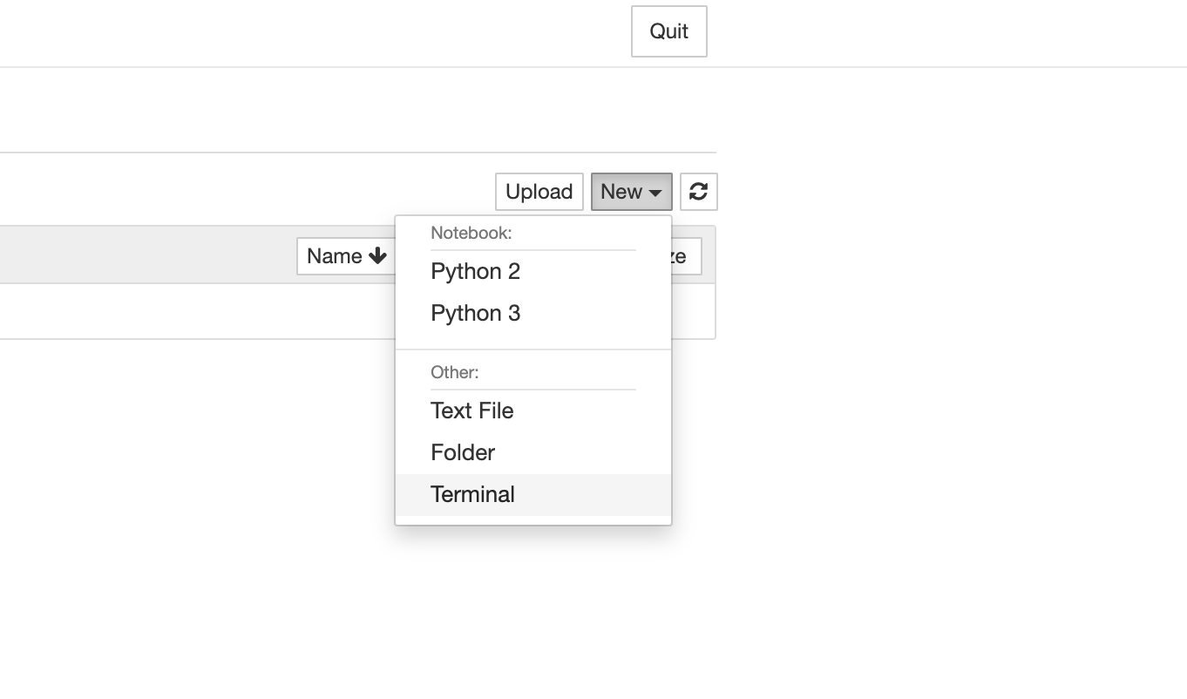
Start Terminal and Git clone*
Step : 10
* www.github.com/pramodsinghwalmart/AI_Conf_London

Slide 78
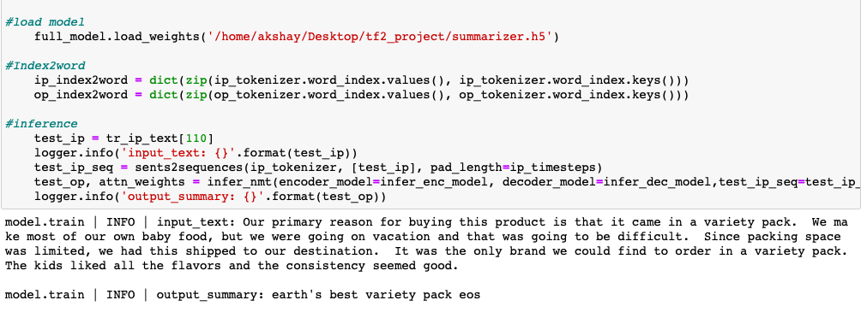
Final result

Slide 79
Productionization

Slide 80
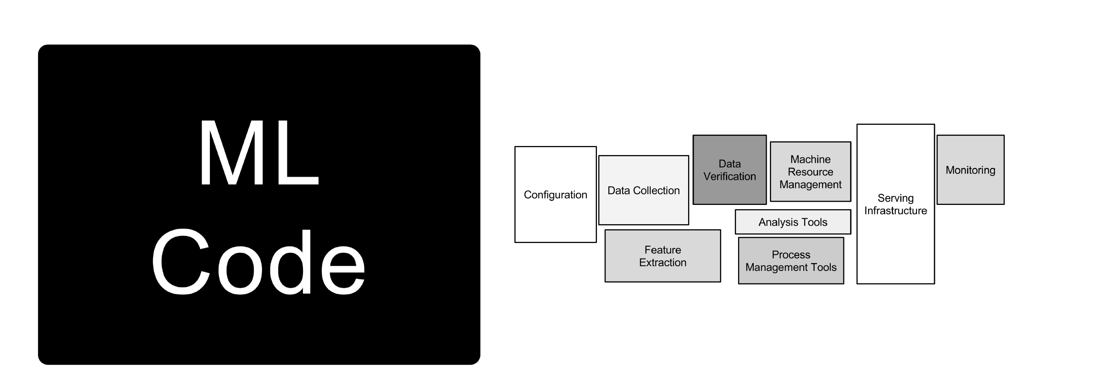
*Image Credits : “Kubeflow Explained” at Strata 2018 by Michelle Casbon

Slide 81
*Image Credits : “Kubeflow Explained” at Strata 2018 by Michelle Casbon

Slide 82
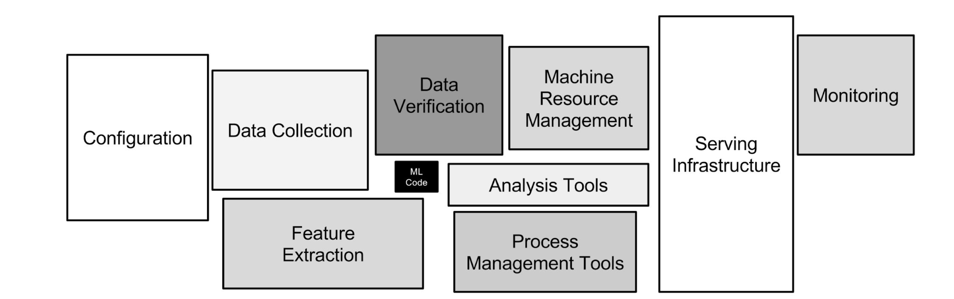
*Image Credits : “Kubeflow Explained” at Strata 2018 by Michelle Casbon

Slide 83
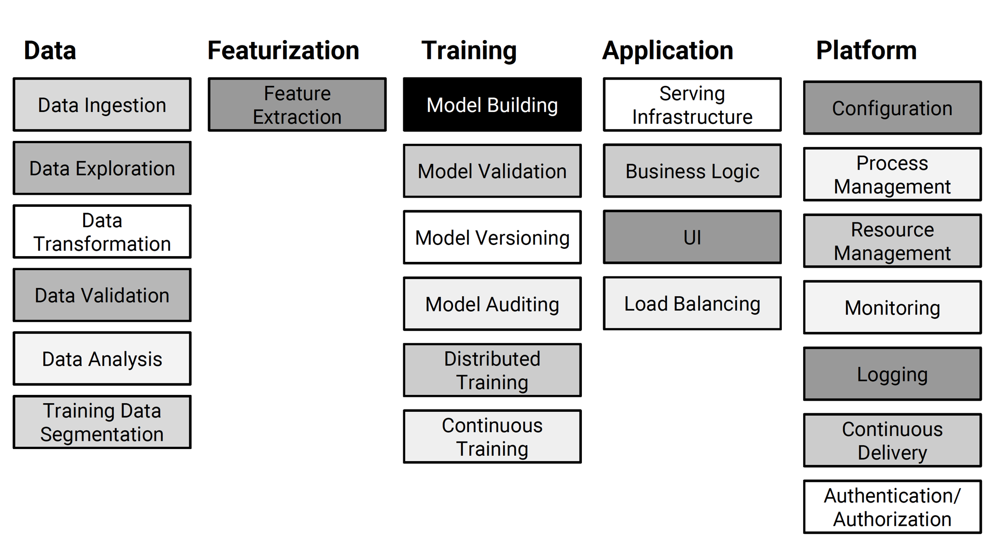
*Image Credits : “Kubeflow Explained” at Strata 2018 by Michelle Casbon

Slide 84
Issues with Manual Management
Security issues — No control over ports/access
Costs — Big chance of over-provisioning resources
Costs — No guarantee the machine is stopped/killed once the task is completed
Setup time — All these manual steps can take time & mistakes can be made
Flexibility — Moving models to production can be quite cumbersome
Monitoring — No centralized logging & monitoring
Workflow — Hard to execute tasks on a separate machine that are part of a bigger workflow

Slide 85
Underlying technologies

Slide 86
What are Containers ?
Code
Configuration
Dependencies
“Can run on any environment”

Slide 87
What is Kubernetes ?
Provides runtime environment for Docker Containers ( encapsulate application and its dependencies )
Scale and load balance docker containers
Abstract the infra for containers
Declarative definition for running containers
Perform update ( or rolling update )
Service discovery and exposure
Make life easy while working with containers
“Kubernetes has evolved into the de-facto industry standard for container management and for machine learning at scale”

Slide 88
Kubernetes

Slide 89
Why Kubernetes is not enough
Kubernetes jobs are perfectly adequate for a simple examples
Complexity of the training process quickly increases when additional steps are needed like data extraction, data preparation, model testing or post-processing
Often data science code consists of scripts rather than full-fledged applications, and combining all these functions in a single script does not yield the greatest code

Slide 90
Kubeflow

Slide 91
What is Kubeflow ?
“The Machine Learning Toolkit for Kubernetes”
A curated set of compatible tools and artifacts that lays a foundation for running production ML apps

Slide 92
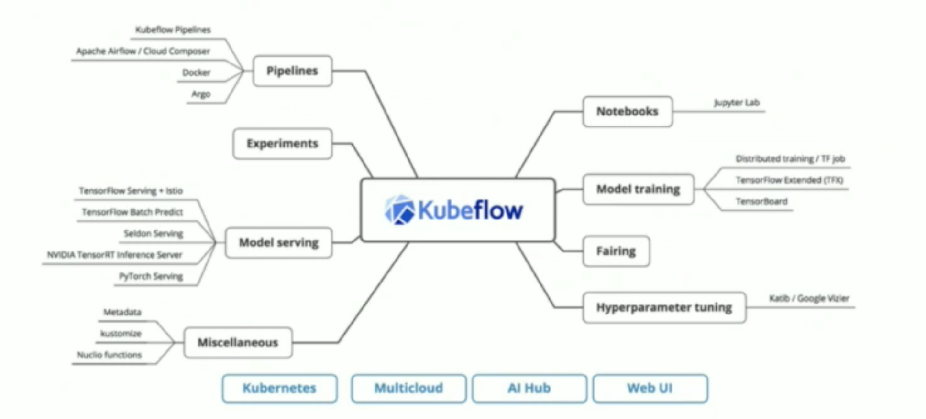
Components

Slide 93
Make it Easy for Everyone to Develop, Deploy and Manage Portable, Distributed ML on Kubernetes
Kubeflow Mission

Slide 94
Challenges
Increased Complexity versus doing it locally
Active Development – Frequent Changes
Community Driven

Slide 95
Thank you

Slide 96
Appendix

Slide 97
References
https://www.analyticsvidhya.com/blog/2019/06/comprehensive-guide-text-summarization-using-deep-learning-python/
https://github.com/thushv89/attention_keras
https://towardsdatascience.com/attn-illustrated-attention-5ec4ad276ee3
https://github.com/spro/practical-pytorch/blob/master/seq2seq-translation/seq2seq-translation.ipynb
https://towardsdatascience.com/illustrated-guide-to-lstms-and-gru-s-a-step-by-step-explanation-44e9eb85bf21

